Slide 1
Needs & beliefs about Self and others
Applying EI Self Theory
Adapted by Dr. Jennifer Wiley and Dr. Kris Acheson-Clair from Shealy (2015) and Brown & Kysilka (2009).
Shealy, C.N. (Ed.). (2015). Making sense of beliefs and values. Springer.
Brown, S.C., & Kysilka, M.L. (2009). What every teacher should know about multicultural and global education. Pearson.

Slide 2
Needs & Beliefs about self and others
Needs
Humans are highly motivated to fulfill them
Exist along a physical-psychological spectrum
Derived from evolutionary adaptation and core human existence (define us as a species)
Expressed uniquely (individual adaptive potential)
Interact with development and formative variables
Are expressed both nonverbally and verbally

Slide 3
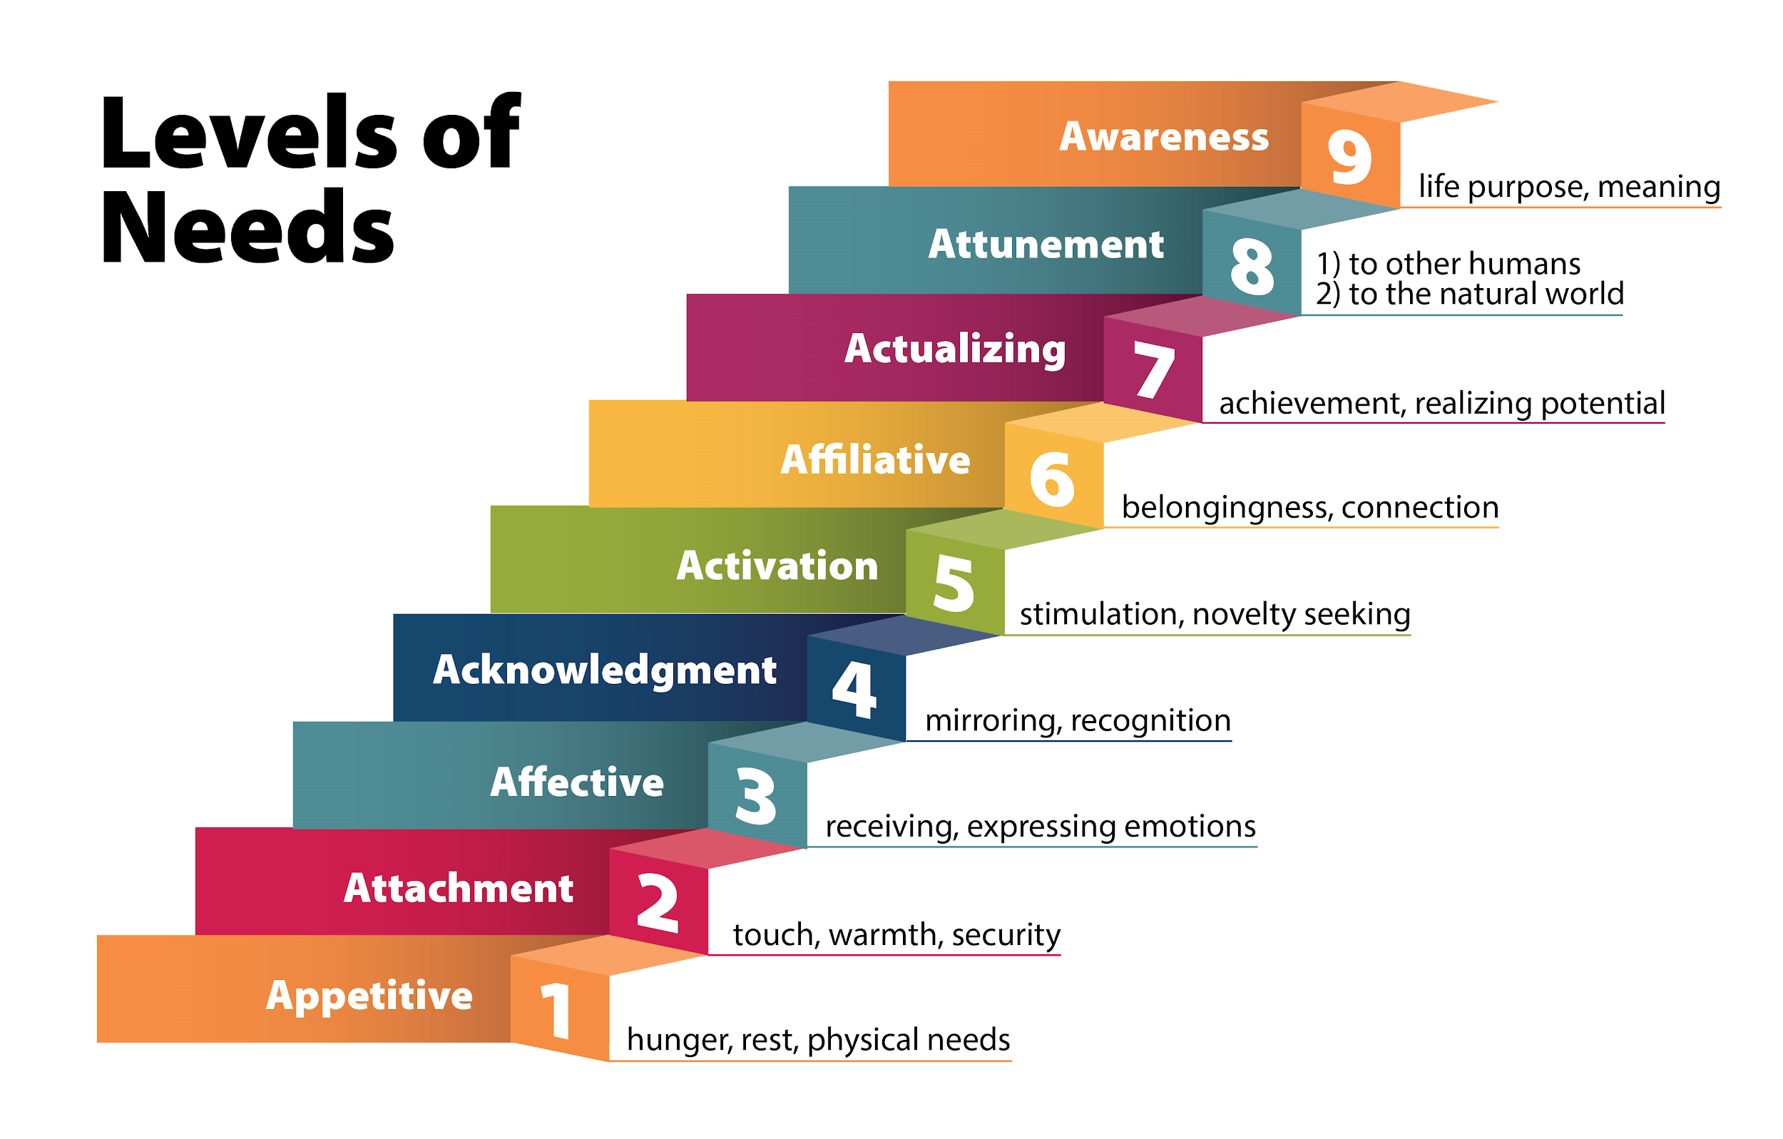
Needs & Beliefs about self and others

Slide 4
Needs & Beliefs about self and others
Self
Highly complex and interdependent system
Derivative of our awareness of our own existence
Experienced in both subjective (I) and objective (me) terms
Encompasses and organizes all aspects of human experience and functioning

Slide 5
Needs & Beliefs about self and others
Equilintegration (EI) Theory
Highly complex and interdependent system
Derivative of our awareness of our own existence
Experienced in both subjective (I) and objective (me) terms
Encompasses and organizes all aspects of human experience and functioning

Slide 6
Needs & Beliefs about self and others
Beliefs & Values are:
The products of experience
Impactful, even when not known or logical
Make up the self
Provide information about and access to the self
Not easily modified
Change other aspects of the self when they change

Slide 7
Needs & Beliefs about self and others
The EI Self — Illustrated

Slide 8
Needs & Beliefs about self and others
Source of Beliefs Structure: Formative Variables
Geography
_______
Race
Ethnicity
Step 1: Sketch a personal culture model like this one on a piece of paper. Take just a few minutes to think about fundamental facets of what makes you who you are. You don’t have to use these examples. Now, choose one facet to focus on in Step 2.
_______
Your Name
Gender
_______
Economic
Social Class
Physical
Ability

Slide 9
Needs & Beliefs about self and others
Source of Beliefs Structure: Formative Variables
Education
Family
Media
Step 2: Think about all the environmental or contextual factors that play a role in this aspect of your identity. There are some examples on this slide but you can certainly add others. Now, choose one contextual factor to focus on in Step 3.
Gender
Friends
Workplace
Travel

Slide 10
Needs & Beliefs about self and others
Source of Beliefs Structure: Formative Variables
Elementary School: Scolded for being “unlady like” when climbing in a dress
Middle School: Teased for slower physical development
Step 3: Based on the facet you chose from the first step and the contextual factor from the second step, consider how conversations, memories of images or media, stories shared by family or friends may have impacted what you believe about this facet of yourself. See the graphic to the left for a model.
Education
Gender
High School: Males are athletes and focus of events, females are cheerleaders on sidelines
High School: Male math teacher encouraged girls to learn math for science careers

Slide 11
Needs & Beliefs about self and others
Source of Beliefs Structure: Formative Variables
Step 4: Put the examples you generated in Step 3 in the language of EI Theory.
How were those needs met or not met?
Not met: The words and actions of adults/peers suggested that I was not capable of certain physical activities and that I was meant to play a “supporting role” because of my gender identity.
Met: The words and actions of my math teacher led me to believe that I was capable of an intellectually rigorous STEM career.
How did those experiences shape your beliefs and values?
I believed that girls/women were just as smart as boys/men, but that it would be difficult for a girl/woman to take on a leadership role. Therefore, I never attempted to become a leader.
What needs did you have?
Needed to feel empowered/strong and feel confident in my ability to accomplish physical and intellectual tasks.

